Slide 1

Python Introduction
David_Chu
2021/4/25

Slide 2
Directory
Python install for Windows (Python 3.9.2)
Anaconda install for Windows (Spyder4)
Python
Package Install (Pip install)
Common
Data Type
Data Structure (Tuple(),List[], Set{}, dict{})
Flow control
Module
Exception
Object-oriented programming
Class
Encapsulation
Inheritance
Abstract Class
Polymorphism
Reference

Slide 3
Python Install

Slide 4
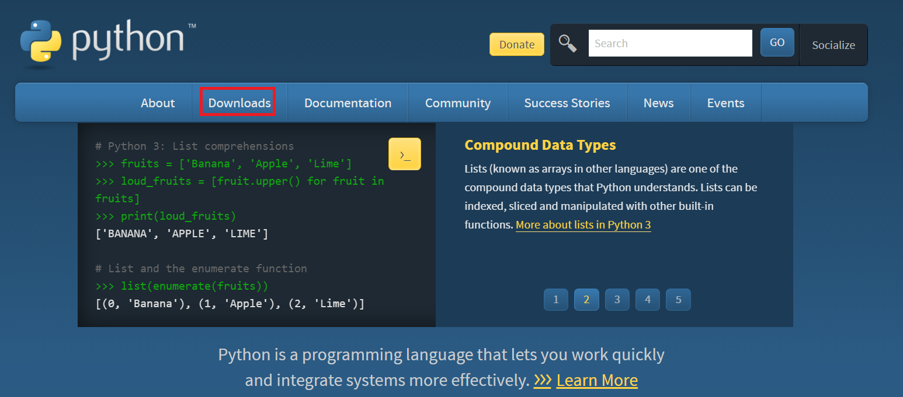
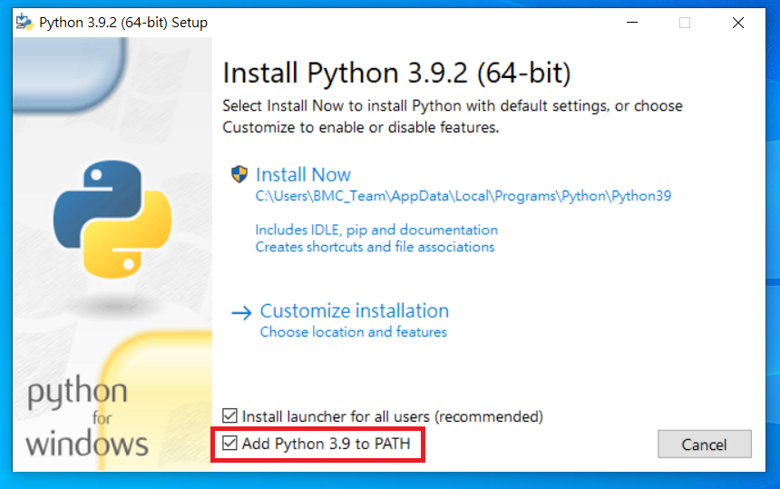
Python Install
https://www.python.org/downloads/

Slide 5
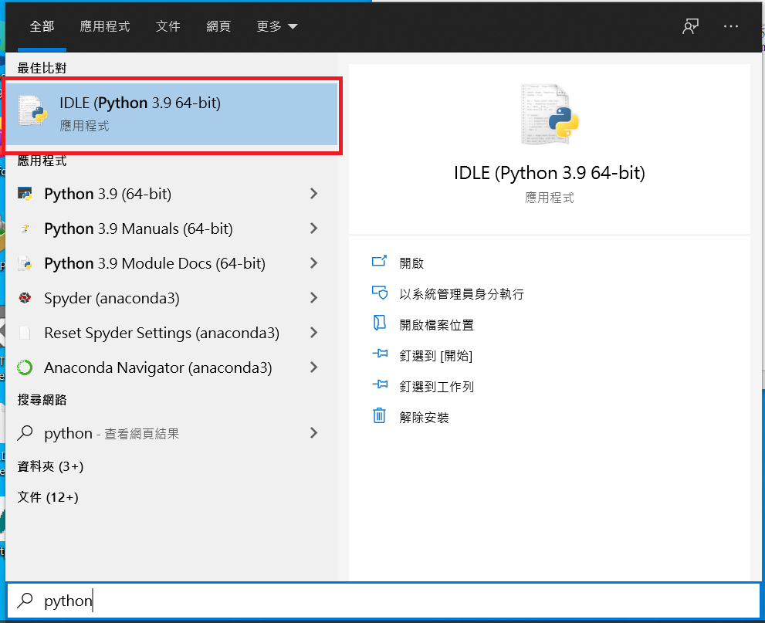
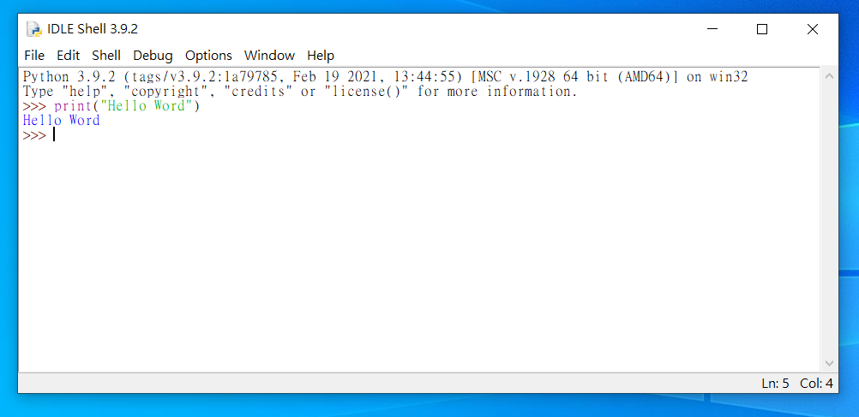
Python Install

Slide 6
Anaconda(Spyder)

Slide 7

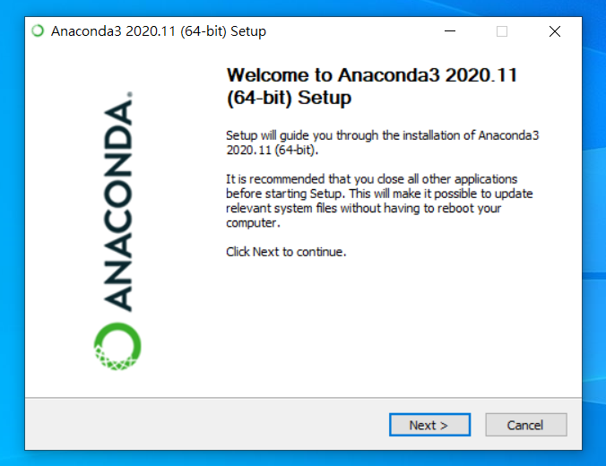
Anaconda (Spyder)
https://www.anaconda.com/products/individual

Slide 8
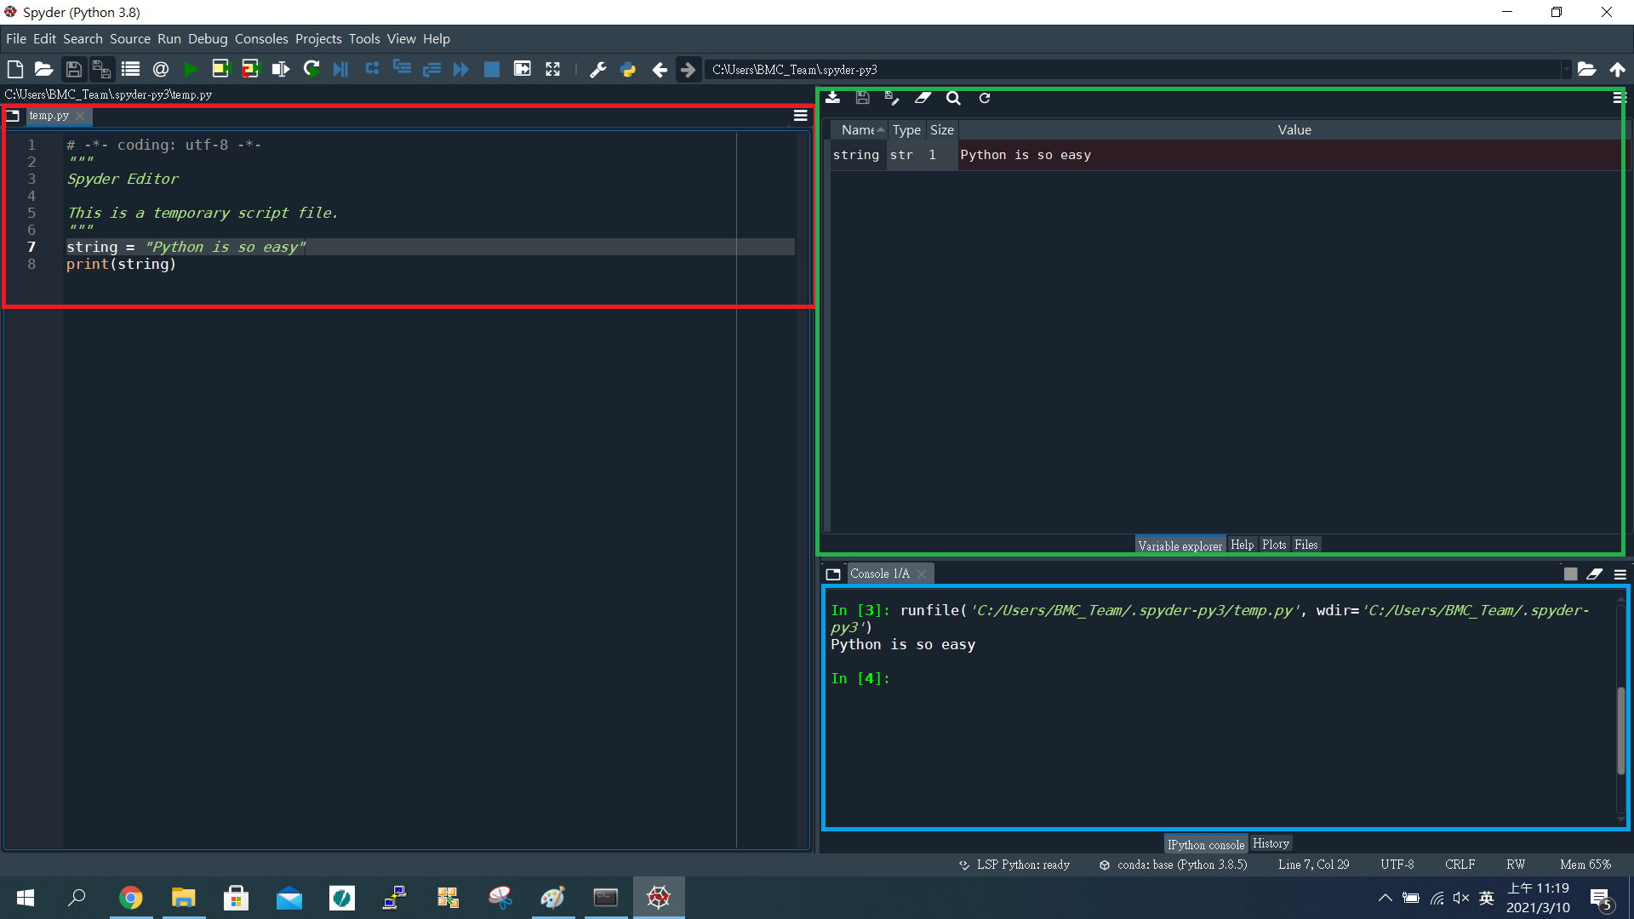
Anaconda (Spyder)
Browse tabs
Variables explorer
Console

Slide 9
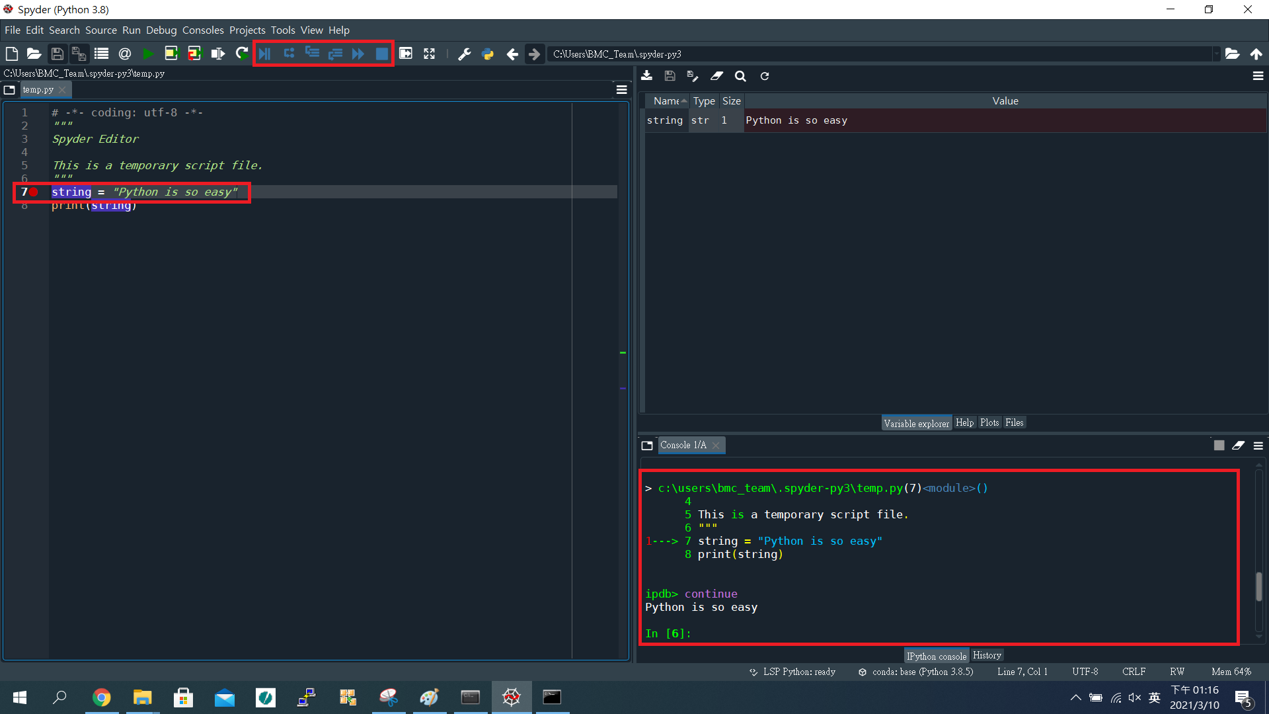
Anaconda (Spyder)
Debug mode

Slide 10
Package Install

Slide 11
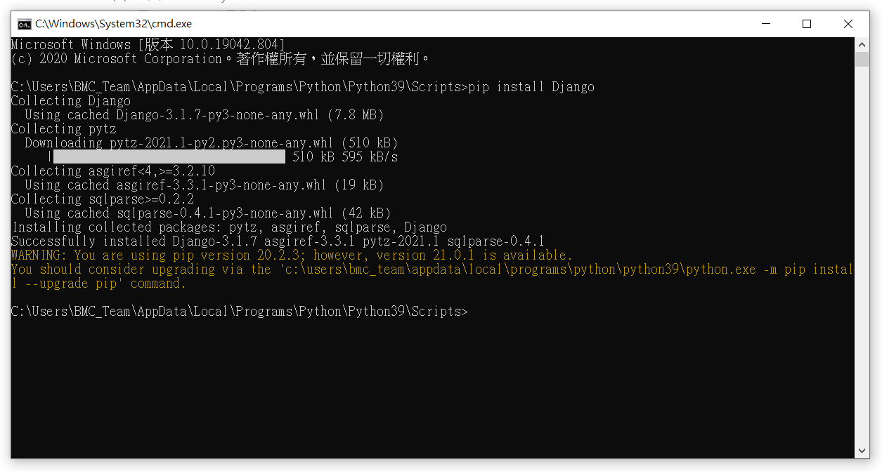
Package Install (Python)
$ pip install $PackageName

Slide 12
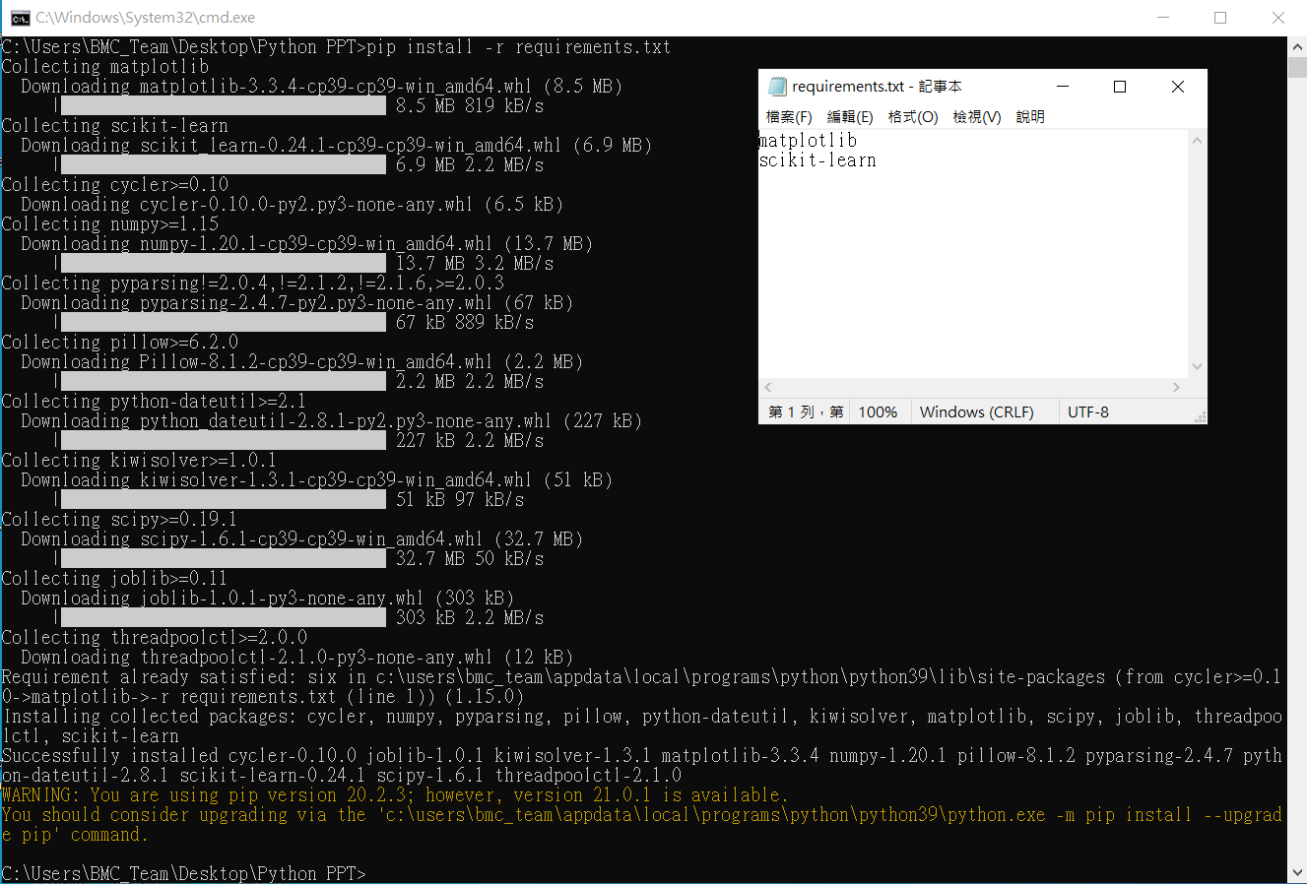
Package Install (requirements.txt)
$ pip install -r requirements.txt

Slide 13
Common

Slide 14
Common(Keyword)
False | class | finally | is | Return
None | continue | for | lambda | Try
True | def | from | nonlocal | While
and | del | global | not | With
as | elif | if | or | Yield
assert | else | import | Pass
break | except | in | Raise
* Don’t used to name the variable

Slide 15
Common(Built-in functions)
abs() | delattr() | hash() | memoryview() | set()
all() | dict() | help() | min() | setattr()
any() | dir() | hex() | next() | slice()
ascii() | divmod() | id() | object() | sorted()
bin() | enumerate() | input() | oct() | staticmethod()
bool() | eval() | int() | open() | str()
breakpoint() | exec() | isinstance() | ord() | sum()
bytearray() | filter() | issubclass() | pow() | super()
bytes() | float() | iter() | print() | tuple()
callable() | format() | len() | property() | type()
chr() | frozenset() | list() | range() | vars()
classmethod() | getattr() | locals() | repr() | zip()
compile() | globals() | map() | reversed() | __import__()
complex() | hasattr() | max() | round()
* Don’t used to name the function

Slide 16
Common(Variable name)
1. First word should be English or _.
2. After the first word that can used English, numeric or _ .

Slide 17
Common(Arithmetic operator)
+ | 加 | a+b
- | 減 | a-b
* | 乘 | a*b
/ | 除 | a/b
% | 取餘數 | a%b

Slide 18
Common(Comparison operator)
< | 小於 | a < b
> | 大於 | a > b
<= | 小於等於 | a <= b
>= | 大於等於 | a >= b
== | 相等 | a == b
!= | 不相等 | a != b
* It will return the Boolean type

Slide 19
Data Type

Slide 20
Data Type
Numeric type
Integer (int)
Floating-point (float)
Boolean (bool)
Text type
String (str)
Sequence type
List
Tuple
4. Set type
set
Mapping type
dict

Slide 21
Data Type (Integer)
x = 1 # Assign 1 to x print(x) # print x print(type(x)) # print x type

Slide 22
Data Type (Float)
x = 1.5 # Assign 1.5 to x print(x) # print x print(type(x)) # print x type

Slide 23

Data Type (Str)
x = “string” # Assign “string” to x print(x) # print x print(type(x)) # print x type

Slide 24
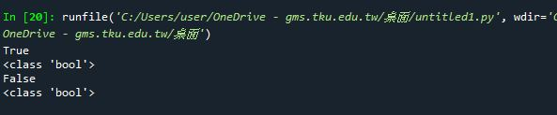
Data Type (bool)
x = True # Assign “True” to bool x
y = False # Assign “False” to bool y
print(x) # print x print(type(x)) # print x type
print(y) # print x print(type(y)) # print x type

Slide 25
Data Structure

Slide 26

Data Structure (Tuple)
y = False #Assign “False” to bool y
x = ( 1 ,“string”, y) #Assign (1, “string”, y) to tuple x
print(x) #print x
print(type(x)) #print x type

Slide 27
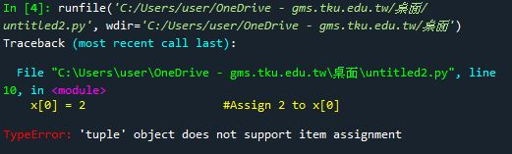
Data Structure (Tuple)
y = False #Assign “False” to bool y
x = ( 1 ,“string”, y) #Assign (1, “string”, y) to tuple x
x[0] = 2 #Assign 2 to x[0]
print(x) #print x
print(type(x)) #print x type
* Tuple object doesn’t support item assignment

Slide 28

Data Structure (List)
y = False #Assign “False” to bool y
x = [ 1 ,“string”, y] #Assign [1, “string”, y] to list x
print(x) #print x
print(type(x)) #print x type

Slide 29

Data Structure (List)
y = False #Assign “False” to bool y
x = [ 1 ,“string”, y] #Assign (1, “string”, y) to tuple x
x[0] = 2 #Assign 2 to x[0]
print(x) #print x
print(type(x)) #print x type
* List object support item assignment

Slide 30

Data Structure (list.append)
y = False #Assign “False” to bool y
x = [ 1 ,"string", y] #Assign [1, “string”, y] to list x
print(x) #print x
print(type(x)) #print x type
x.append("Python") #add “python” to list x
print(x) #print x

Slide 31

Data Structure (list.insert)
y = False #Assign “False” to bool y
x = [ 1 ,"string", y] #Assign [1, “string”, y] to list x
print(x) #print x
print(type(x)) #print x type
x.insert(0,"python") #insert “python” to list x[0]
print(x) #print x

Slide 32

Data Structure (list.remove)
y = False #Assign “False” to bool y
x = [ 1 ,"string", y] #Assign [1, “string”, y] to list x
print(x) #print x
print(type(x)) #print x type
x.remove(y) #remove y from list x
print(x) #print x

Slide 33

Data Structure (Two-dimensional List)
list1 = [[1,2,3], # Assign 1~9 to two-dimensional list
[4,5,6],
[7,8,9]]
print(list1[1][0]) # Print list[1][0]
print(list1[1][1]) # Print list[1][1]

Slide 34
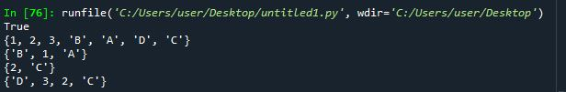
Data Structure (Set)
set1 = {"A","B","C",1 ,2}
set2 = {"A","B","D",1 ,3}
print(“A” in set1) # “A” in set1 or not
print(set1 | set2) # Union (聯集)
print(set1 & set2) # Intersection (交集)
print(set1 - set2) # Subtraction (差集)
print(set1 ^ set2) # XOR (互斥或)

Slide 35

Data Structure (Dict)
dict = {"Name" : "David", "Age" : 28, "Weight" : 70, "Height" : 176}
print(dict["Name"])
print(dict["Age"])
print(dict["Weight"])
print(dict["Height"])

Slide 36
Flow control

Slide 37
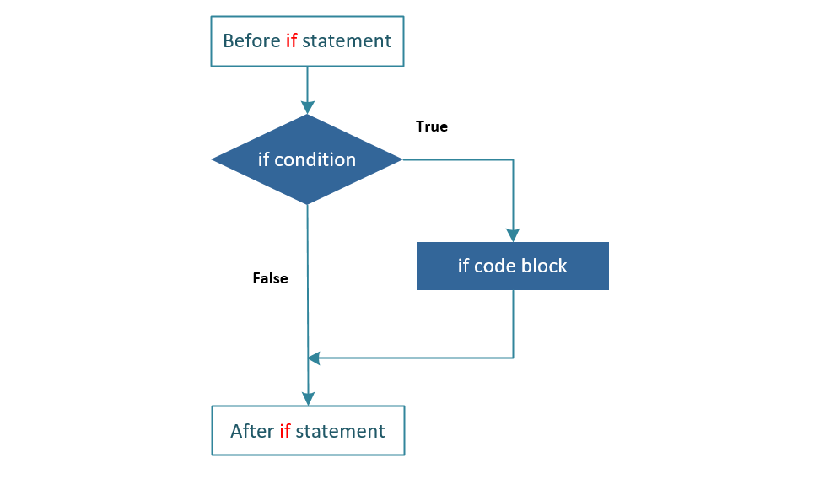
Flow control (If_else)

Slide 38

Flow control (If_else)
x = int(input("Please enter an integer: ")) # Assign input number to x
if x < 50:
print("The Integer is small than 50") # If x < 50, print
elif x > 50:
print("The Integer is more than 50") # If x > 50, print
else:
print("The Integer is 50") # If not meets above, print

Slide 39
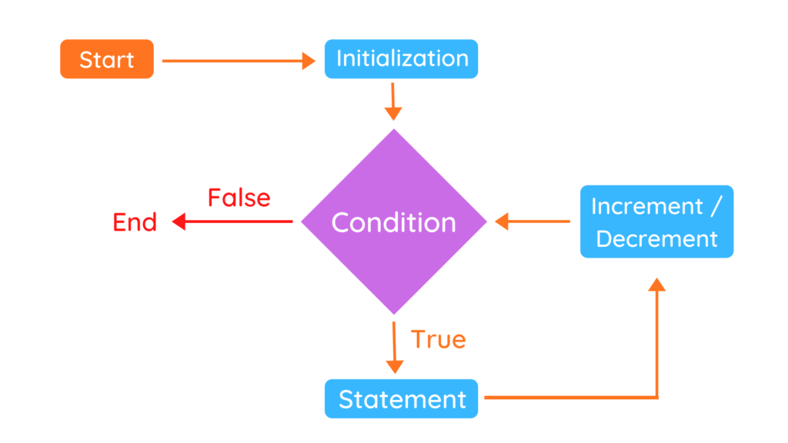
Flow control (for_loop)

Slide 40

Flow control (for_loop)
words = ["Python", "Java", "C++"] # Assign List[] to words
for w in words:
print(w, len(w)) # Print w in words[] and count it.

Slide 41
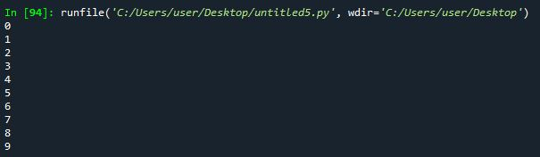
Flow control (for_range)
for i in range(10):
print(i) # Print i from 0 to 9

Slide 42
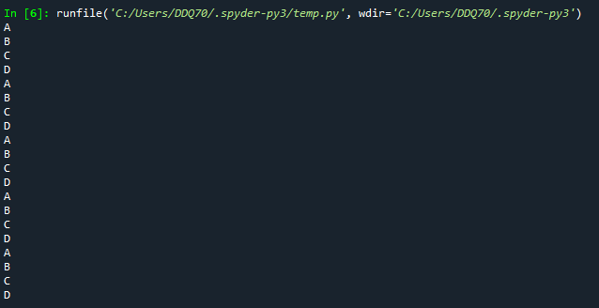
Flow control (nested_loops)
words = [“A”, “B”, “C”, “D”] #Assign “A”, “B”, “C”, “D” to words
for i in range(5):
for j in words:
print(j) #Print j

Slide 43
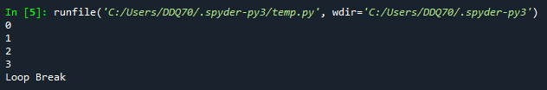
Flow control (break)
for i in range(5):
print(i) #Print i
if i == 3:
print(“Loop Break”) #if i = 3, print “Loop Break” then break loop
break

Slide 44

Flow control (continue)
for i in range(5):
if i == 3: #if i = 3
continue #Bypass then continue loop
print(i) #Print i

Slide 45
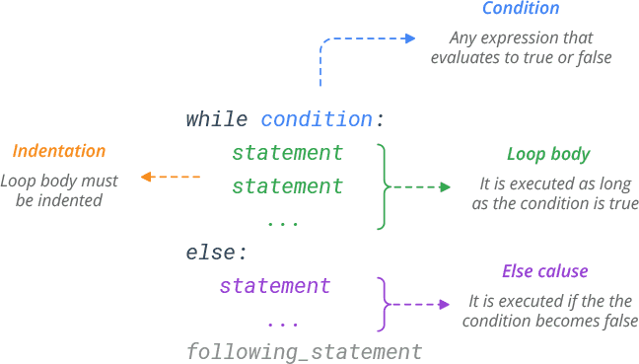
Flow control (while_loop)

Slide 46
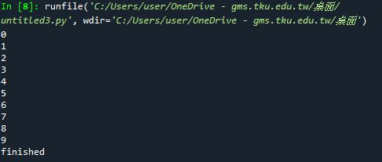
Flow control (while_loop)
i = 0 # assign 0 to i
while i < 10: # if i < 10 is true
print(i) # print i
i += 1 # I + 1
else:
print(“finished”) # if i < 10 is false

Slide 47
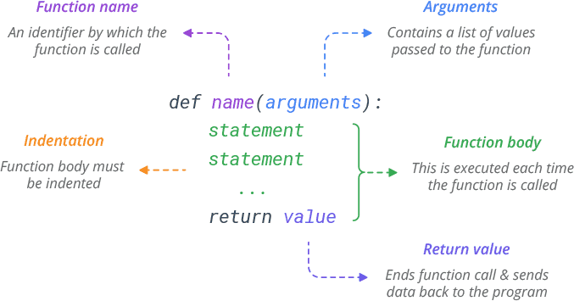
Flow control (function)

Slide 48
Flow control (function)
def example(n): # function example()
n+=5 # n = n + 5
print(n) # print n
example(10) # call function example()

Slide 49
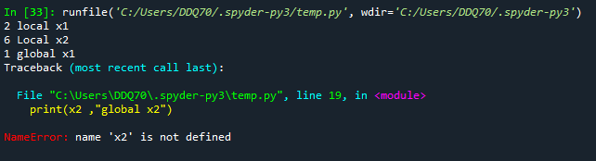
Flow control (global/local variable)
x1 = 1 # Assign 1 to x1
def example(): # Function example()
x1 = 2 # Assign 2 to x1
x2 = 6 # Assign 6 to x2
print(x1,“local x1”) # print local x1
print(x2,”local x2”) # print local x2
example() # call function example()
print(x1, ”global x1”) # print global x1
print(x2, “global x2”) # print global x2

Slide 50
Module

Slide 51
Module
#temp.py
def example1():
print(“example1 function”)
def example2():
print(“example2 function”)
#import.py
import temp
temp.example1()
temp.example2()

Slide 52
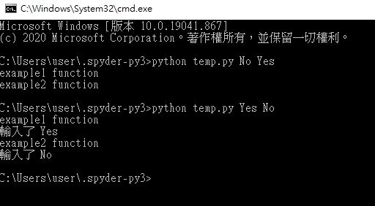
Module (Used by CMD)
#temp.py
import sys
def example1(n):
print("example1 function")
if n == "Yes":
print("輸入了 Yes")
def example2(m):
print("example2 function")
if m == "No" :
print("輸入了 No")
if __name__ == "__main__":
example1(str(sys.argv[1]))
example2(str(sys.argv[2]))

Slide 53
Exception

Slide 54
Exception (Error Type)
# Exception (checking)
# EX : ValueError, NameError, TypeError
# Runtime Exception (unchecking)
# EX : OS crash, HW component error …….
# Can’t be catch by python.

Slide 55
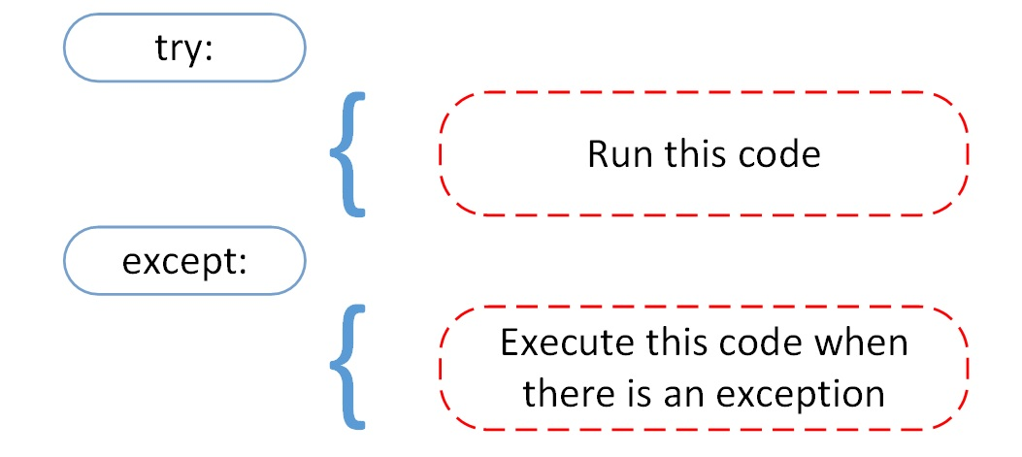
Exception (Error Type)

Slide 56
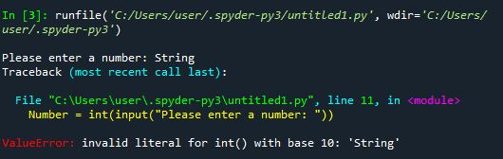
Exception (Error)
# Exception error
Number = int(input( "Please enter a number : "))

Slide 57
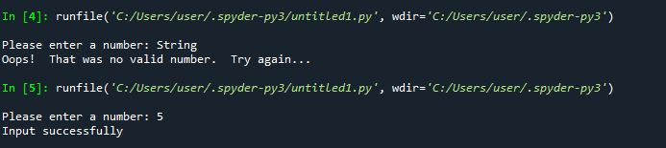
Exception (try_catch)
# Exception error
try:
Number = int(input("Please enter a number: "))
except ValueError:
print("Oops! That was no valid number. Try again...")
else:
print("Input successfully")

Slide 58
Object-oriented Programming

Slide 59
Object-oriented Programming
Encapsulation 封裝 : 一種將函式介面的實作細節部份包裝、隱藏起來的方法，它也是一種防止外界呼叫端，去存取物件內部實作細節的手段。
Inheritance 繼承 : 繼承可以使得子類具有父類別別的各種屬性和方法，而不需要再次編寫相同的代碼。
Polymorphism 多型 : 指為不同資料類型的實體提供統一的介面。

Slide 60
Class (類別)
# Class sample
class baseClassName:
<statement-1>
.
.
.
<statement-N>

Slide 61

Class (類別)
# Animal Class
class baseAnimal: # baseAnimal class
y = "Is not a animal“
def animal(self):
print("Is a animal")
X = baseAnimal() # Implement
print(X.y) # Call y
X.animal() # Call animal method

Slide 62

Class ( __init__ 建構子)
# Animal Class
class baseAnimal:
def __init__(self, name, species):
self.name = name
self.species = species
def animal(self):
print("Is a animal")
X = baseAnimal('LaLa', 'Cat')
print(X.name)
print(X.species)
X.animal()
#__init__ 作為設定物件初始化資料使用

Slide 63
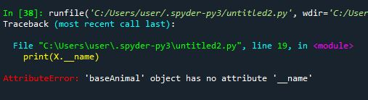
Encapsulation (封裝)
# Animal Class
class baseAnimal: #透過封裝防止內部資料直接被外部呼叫
def __init__(self, name, species):
self.__name = name
self.__species = species
def animal(self):
print("Is a animal")
X = baseAnimal('LaLa', 'Cat')
print(X.__name)
print(X.__species)
X.animal()

Slide 64

Encapsulation (封裝)
# Animal Class
class baseAnimal:
def __init__(self, name, species):
self.__name = name
self.__species = species
def getAnimalName(getname):
return getname.__name
def getAnimalSpecies(getspecies):
return getspecies.__species
X = cat("LaLa","Cat")
print(X.getAnimalName())
print(X.getAnimalSpecies())
#透過 Method 回傳被封裝的資料

Slide 65
Inheritance (繼承)
# Inheritance
class DerivedClassName(BaseClassName):
<statement-1>
.
.
.
<statement-N>

Slide 66

Inheritance (繼承)
# Animal Class
class baseAnimal:
def __init__(self, name, species):
self.__name = name
self.__species = species
def getAnimalName(getname):
return getname.__name
def getAnimalSpecies(getspecies):
return getspecies.__species
class cat(baseAnimal):
def update(self):
return "喵喵叫"
X = cat("LaLa","Cat")
print(X.getAnimalName()) #透過繼承取得父類別 Method
print(X.getAnimalSpecies())
print(X.update())

Slide 67
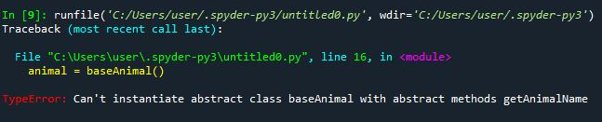
Abstract Class (抽象類別)
# Abstract Class
from abc import ABC, abstractmethod
class baseAnimal(ABC):
@abstractmethod
def getAnimalName(getname):
pass
@abstractmethod
def getAnimalSpecies(getspecies):
pass
animal = baseAnimal() #抽象類別無法被直接實例化

Slide 68

Abstract Class (抽象類別)
# Abstract Class
from abc import ABC, abstractmethod
class baseAnimal(ABC):
@abstractmethod
def getAnimalName(getname):
pass
@abstractmethod
def getAnimalSpecies(getspecies):
pass
class cat(baseAnimal): #抽象類別需透過繼承來實現
def __init__(self,name,species):
self.name = name
self.species = species
def getAnimalName(self):
print(self.name)
def getAnimalSpecies(self):
print(self.species)
cat1 = cat("Lala","橘貓")
cat1.getAnimalName()
cat1.getAnimalSpecies()

Slide 69
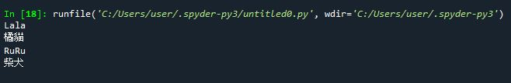
Polymorphism (多型)
# Abstract Class
from abc import ABC, abstractmethod
class baseAnimal(ABC):
@abstractmethod
def getAnimalName(getname):
pass
@abstractmethod
def getAnimalSpecies(getspecies):
pass
class cat(baseAnimal):
def __init__(self,name,species):
self.name = name
self.species = species
def getAnimalName(self):
print(self.name)
def getAnimalSpecies(self):
print(self.species)
class dog(baseAnimal):
def __init__(self,name,species):
self.name = name
self.species = species
def getAnimalName(self):
print(self.name)
def getAnimalSpecies(self):
print(self.species)
cat1 = cat("Lala","橘貓")
dog1 = dog("RuRu", "柴犬")
cat1.getAnimalName() #透過不同的實例化物件來呼叫 Method
cat1.getAnimalSpecies()
dog1.getAnimalName() #透過不同的實例化物件來呼叫 Method
dog1.getAnimalSpecies()

Slide 70
Reference
Python download
https://www.python.org/downloads/
Anaconda download
https://www.anaconda.com/products/individual
Python Document
https://docs.python.org/zh-tw/3/tutorial/index.html
Python Learn by example
https://www.learnbyexample.org/python-introduction/

Slide 71
Q&A

